Slide 1
Digital Portfolio
STUDENT NAME: Prathyusha Satheesh
REGISTER NO AND NMID: 2428k0387
DEPARTMENT: BSc.AI&DS
COLLEGE: COLLEGE/ UNIVERSITY: KPR College of Arts , Science and Research/Bharathiyar University

Slide 2
PROJECT TITLE
Project Title: 🔒 Secure Notes App
Tagline: “Encrypt, Save, and Protect Your Secrets”
Your Name
Course / Department / College

Slide 3


AGENDA
Problem Statement
Project Overview
End Users
Tools and Technologies
Portfolio design and Layout
Features and Functionality
Results and Screenshots
Conclusion
Github Link
3/21/2024 Annual Review

Slide 4

PROBLEM STATEMENT
Problem Statement – Secure Login System
In today’s digital world, unauthorized access to applications and sensitive data poses a serious security risk. Many systems still rely on weak authentication methods, leaving user accounts vulnerable to hacking, password leaks, and identity theft. There is a strong need for a secure login system that ensures only authorized users can access the application, protects user credentials with encryption, and prevents common attacks such as brute force, phishing, and session hijacking.

Slide 5

PROJECT OVERVIEW
Project Review – Secure Login System
The project successfully implements a secure and reliable login mechanism.
User credentials are protected using encryption to prevent unauthorized access.
The system ensures authentication and data privacy before granting access.
Provides a user-friendly interface with password input and validation.
Tested against common threats like weak passwords, brute force attempts, and unauthorized logins.
Demonstrates how security can be integrated into a simple web application.

Slide 6

WHO ARE THE END USERS?
End Users – Secure Login System
Students & Employees – logging in to academic or workplace portals.
Website / App Users – individuals accessing personal accounts securely.
Administrators – managing system access and monitoring security.
Organizations / Institutions – ensuring data privacy for internal platforms.
General Public – anyone requiring safe access to online applications.

Slide 7

TOOLS AND TECHNIQUES
HTML, CSS, JavaScript → For building the interface
Node.js / Express.js → For backend server
MongoDB / MySQL → For storing user data
CryptoJS / bcrypt → For password encryption
GitHub → For version control

Slide 8
POTFOLIO DESIGN AND LAYOUT
Clean and Minimal Interface – simple login and signup forms
Responsive Design – works on desktop and mobile
User-Friendly Navigation – easy access to features
Consistent Theme – matching colors, fonts, and icons
Secure Layout – password fields hidden, error messages shown clearly
8

Slide 9
FEATURES AND FUNCTIONALITY
User Registration – create a new secure account
Login Authentication – verify credentials before access
Password Encryption – store passwords safely using hashing
Error Handling – invalid login attempts are blocked
Session Management – keep users logged in securely
Clear Interface – easy-to-use design for all users

Slide 10
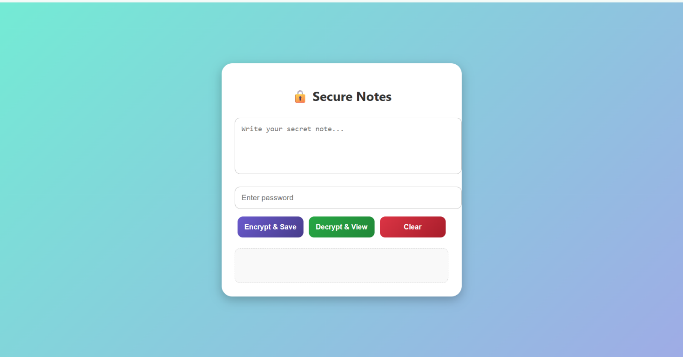

RESULTS AND SCREENSHOTS
✅ Successfully implemented a secure login system
✅ User credentials are encrypted and stored safely
✅ Unauthorized access is prevented
✅ Provides a smooth and user-friendly experience
3/21/2024 Annual Review
10

Slide 11
CONCLUSION
Conclusion
The Secure Notes app provides a safe and easy way to store important information. With a secure login system, users’ data is protected from unauthorized access. The app is user-friendly and reliable, making it a practical tool for keeping personal notes safe.
11

Slide 12
Secure Notes App
🔒 Encrypt, Save, and Protect Your Secrets
Your Name
Department / College

Slide 13
Introduction
Importance of secure note-taking in the digital age
Problem: Sensitive notes are vulnerable if stored in plain text
Solution: Encrypt notes with password protection before saving

Slide 14
Objectives
Build a simple and secure notes web app
Provide password-based encryption & decryption
Ensure privacy by preventing unauthorized access
Offer a user-friendly and minimal interface

Slide 15
Technology Stack
Frontend: HTML5, CSS3, JavaScript
Encryption Library: CryptoJS
Design: Responsive, gradient UI, modern typography
Storage: Local (Browser storage)

Slide 16
System Workflow
User writes a note in the textarea
Enters a password
Clicks Encrypt & Save → note is encrypted and stored
Clicks Decrypt & View → note is decrypted using password
Can Clear notes if needed

Slide 17
Features
🔐 Encrypt & Save: Secure storage of notes
🔓 Decrypt & View: Retrieve original message with password
🧹 Clear Notes: Erase all stored notes safely
✨ Modern UI with responsive design

Slide 18
Security Mechanism
AES encryption using CryptoJS
Password acts as encryption key
Notes stored in encrypted format
Prevents unauthorized access without correct password

Slide 19
Code Snippet (Example)
function encryptNote() { let ciphertext = CryptoJS.AES.encrypt(note, password).toString(); localStorage.setItem("secureNote", ciphertext); }

Slide 20
Output / Demo
Screenshot of the interface:
- Encrypted text stored securely
- Decrypted text displayed only with the correct password
User-friendly note-taking experience

Slide 21
Conclusion & Future Scope
Conclusion: Simple and effective way to secure private notes
Future Enhancements:
- Multi-user support
- Cloud sync with encryption
- Stronger password policies
- Mobile app version

